Slide 1
The National Fraud Initiative in Scotland
Anne Cairns
July 2018

Slide 2

Fraud & irregularities
Public sector fraud & the role of auditors
The National Fraud Initiative

Slide 3

Role of auditors
Audited bodies are responsible for establishing arrangements for the prevention and detection of fraud, error and irregularities, bribery and corruption.
ISAs include certain requirements relating to the auditor’s consideration of fraud. The nature of public sector organisations means that there are specific fraud risks that are relevant to a public sector audit.
These include taxation receipts, welfare benefits, and grants.

Slide 4
The National Fraud Initiative
The National Fraud Initiative in Scotland is a counter-fraud exercise led by Audit Scotland, and overseen by the Cabinet Office for the UK as a whole.
NFI runs every two years and uses computerised techniques to compare information about individuals held by different public bodies that might suggest the existence of fraud or error.
AppCheck - access to the information required to evaluate applications.
ReCheck - a flexible data matching service which complements the national exercise and can help identify fraud earlier.

Slide 5
Key features of the NFI

Slide 6
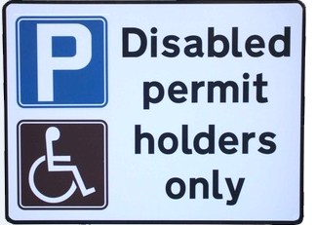
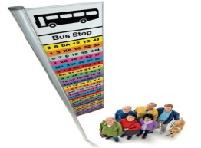
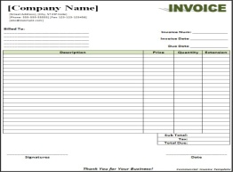

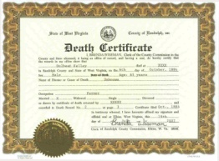

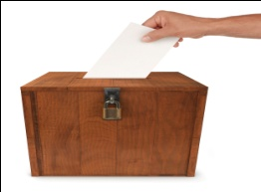
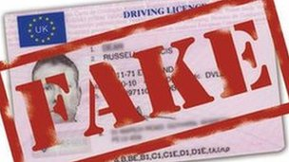










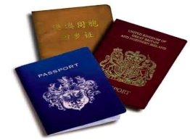





The NFI Data
Blue Badges
Concessionary Travel Pass
Creditors
Council Tax
DWP & DDRI Deceased Persons
Deferred Pensions
Electoral Roll
Fraud Data (Amberhill)
Housing Benefit Claimants
Housing Tenants
Insurance Claimants
Market Traders
Occupational Pensions
Payroll
Right To Buy
Personal Alcohol Licences
Private Residential Care Homes
Student Loans
Taxi Drivers
UKBA Immigration Data
Waiting Lists
Council Tax Reduction
Personal Budgets (direct payment)
Companies House
State Benefits

Slide 7
The National Fraud Initiative
Outcomes of £18.6m in Scotland- £301m across the UK
Cumulative outcomes £1.69 billion across UK

Slide 8
NFI Key outcomes

Slide 9

Case study
Another adult was resident in a property where a customer was receiving a council tax SPD.
The tenant's brother had been the only person in the property
The tenant had also submitted several applications to buy the council property under the "right to buy" scheme
The "right to buy" application was cancelled -£15,000 discount lost
The council tenancy signed back to the council
Council records have been updated & tenant's brother is now liable for £1745 council tax.

Slide 10

Case study – App check
An individual applied to East Dunbartonshire Council for a taxi licence.
AppCheck discovered that the applicant has a Glasgow address and also a tenancy in Milton Keynes. The investigation led to Milton Keynes Council recovering their property.

Slide 11
The future…
The Digital Economy Act
New data sets
Pilot activity
Training/updates in the Autumn
More frequent matches released?
New participants - volunteers?

Slide 12


Contact
Anne Cairns
Manager (Professional Support)
0131 625 1926 or 07976630963
acairns@audit-scotland.gov.uk

